Slide 1


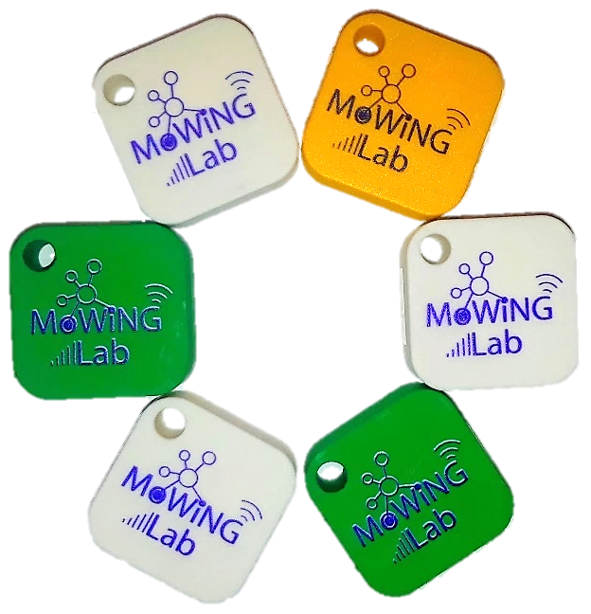
Campus Bluetooth Tag Network
Faculty research project with Dr. Bulut
Team members:
Nicholas Bennett
Jordan Mays-Rowland
Justin Yirka
Goal: Design a system with iOS and Android apps as an alternative to item-tracking products such as Tile and TrackR.

Slide 2
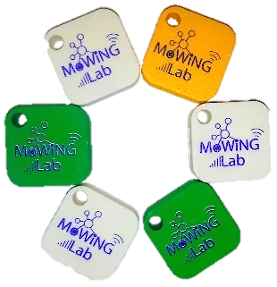
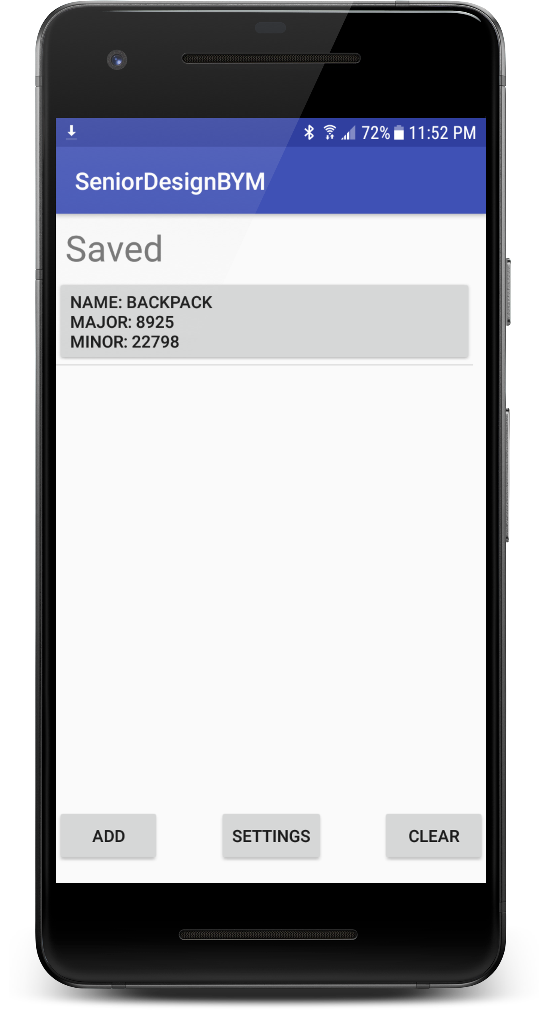
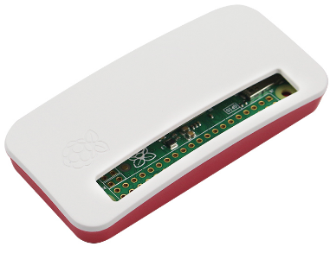
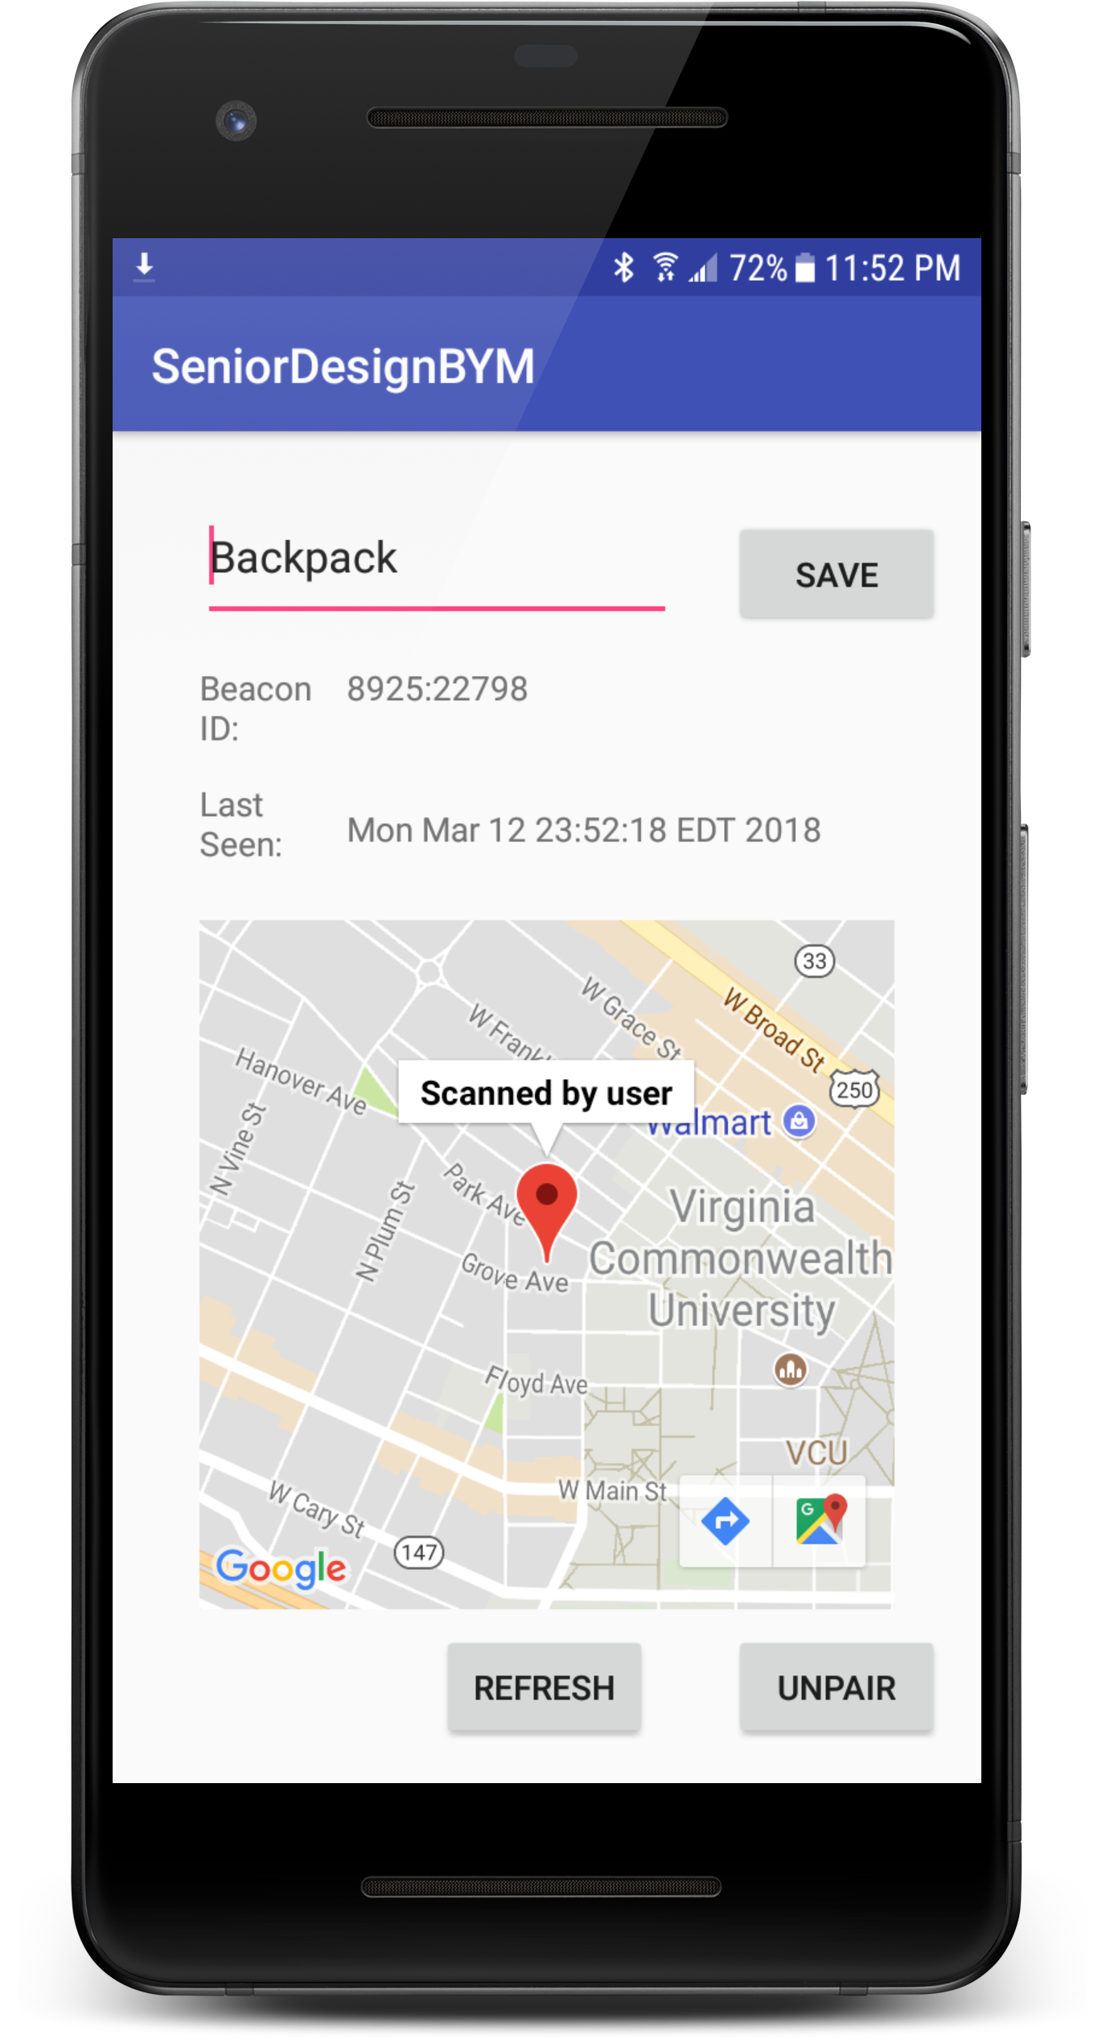




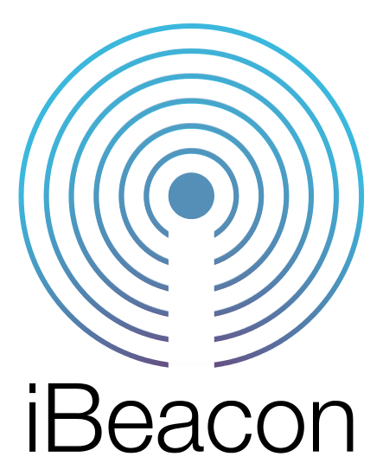



Product
Bluetooth Low Energy (BLE) tags
Custom ordered
Attachable to user’s keys, bag, and more
Fixed scanners
Implemented with Raspberry Pis
Locations customized to campus to provide precise observations, even inside buildings
Passive, anonymous scanning
Any device on network can automatically report observations of a user’s tag
Tag Owner
Able to recover lost items
Access to a tag’s information is restricted to its owner
Cloud
Implemented using Google Firebase
Realtime database & backend processing

Slide 3

Improvements vs current products
Crowd density & CrowdGPS
Customization to campus with fixed scanners
Implemented with Raspberry Pis
Partnership with campus police
Security and privacy

Slide 4

Results
We purchased 80 tags and conducted a small beta test with students on campus.
User feedback was used to identify bugs, improve usability, and plan future features.
Load testing with more users identified improvements to our database design.
Findings and code from this project may be used in future research projects.

